Slide 1

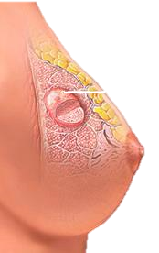
Breast Cancer
Prediction

Slide 2
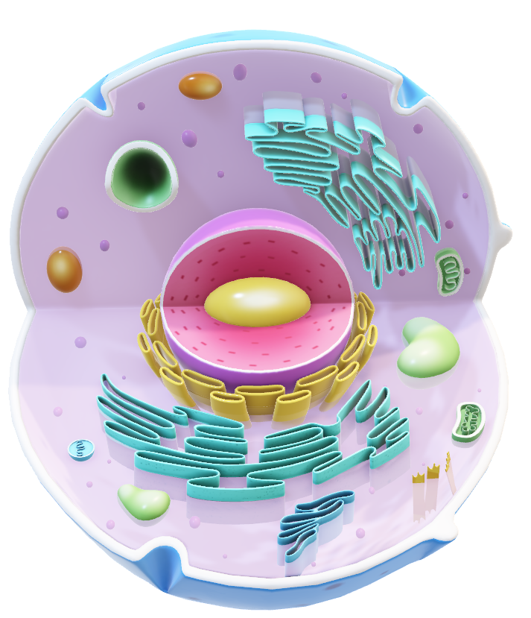
‘M’
Malignant
DATASET
DESCRIPTION
Benign
‘B’
Dataset Description
Real Valued Features of Nucleus
ID Number
Diagnosis
Radius
Texture
Perimeter
Area
Smoothness
Compactness
Concave points
Symmetry
Fractal dimension
Fractal geometry

Slide 3
Checked for missing values
Converted diagnosis to binary
Checked for duplicate rows
33
Number of Columns
3
Column Categories
10
No. features each
Mean
Std. Error
Worst Values
Data examination
Data cleaning

Slide 4
Checked for missing values
Converted diagnosis column to binary.
Checked for duplicate rows
33
Number of Columns
3
Column Categories
10
No. features each
Mean
Std. Error
Worst Values
Data examination
Data cleaning

Slide 5
Correlation Between
Diagnosis and Variables
100th
75th
PERCENTILE
25th
0th
Radius
Texture
Perimeter
Area
Smooth
Compact
Con Points
Symmetry
Frac dim
Frac geo

Slide 6
Training Models
Logistic Regression (0.97)
Support Vector Machine (0.96)
Gradient Boosting Classifier (0.96)
Artificial Neural Network (0.96)
Random forest (0.95)
K-Nearest Neighbors (0.95)
Naïve Bayes (0.95)
Decision Tree (0.95)
Logistic Regression
97%
Accuracy

Slide 7





TEAM
SOS Pi Group 4

Slide 8




TEAM
MAVIS

Slide 9
Thank you!
SOS Pi Group 4

Slide 10
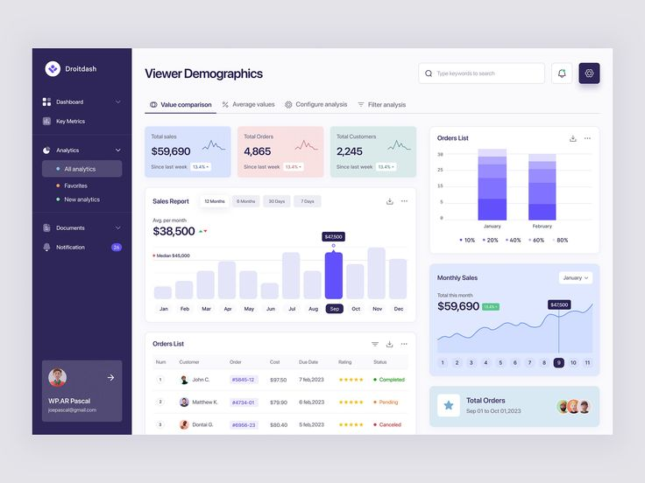
Benign Characteristics
Malignant Characteristics

Slide 11
Todos
Reduce technical jargons.
Explain that breast masses are extracted and cells in these masses are viewed to check the characteristic of their nucleus.
Train a model to predict based on learned data.
Being able to predict breast cancer.
Logistic regression, with 97% accuracy to make the prediction.

